Slide 1


Welcome
Nav Chohan
Chair of the Leeds City Region Skills Network

Slide 2
Interact
Slido.com
#FormulaForSuccess

Slide 3
Nav Chohan
Chair of the Leeds City Region Skills Network

Slide 4
Roger Marsh, OBE
Chair of the Leeds City Region Enterprise Partnership and NP11

Slide 5
Rashik Parmar, MBE
Chair of the Employment and Skills Panel, IBM Fellow and Vice President Technology

Slide 6
Leeds City Region
Skills Network
SHOWCASE

Slide 7
The elements of
SUCCESS

Slide 8
Showcasing our members’ work with businesses in the Leeds City Region

Slide 9


Slide 10


INNOVATION
COLLABORATION
Notes:
This project follows the elements of success, Innovation and Collaboration

Slide 11
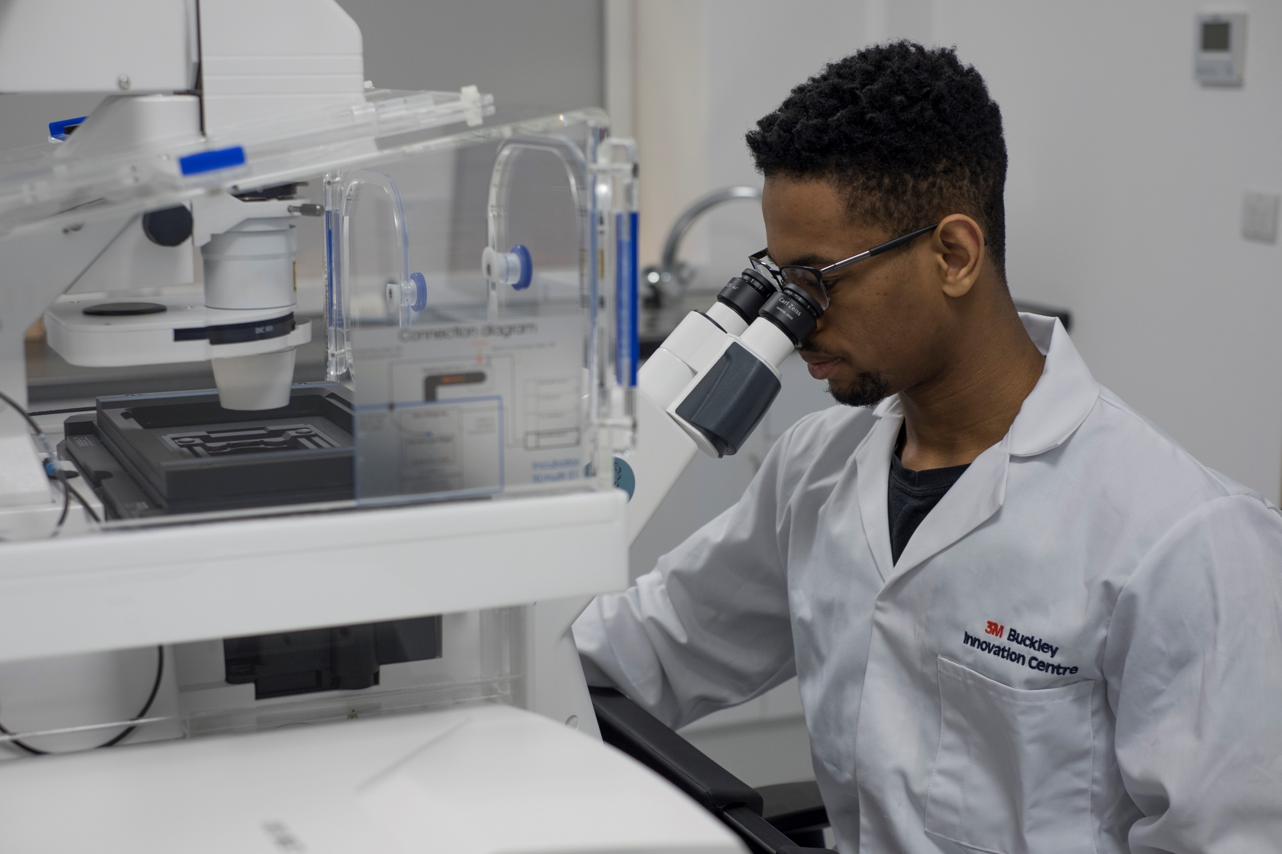

Slide 12
Facilitate business growth
Encourage business to academia collaboration
Actively promote innovation
Notes:
The goals and what the project set out to achieve

Slide 13
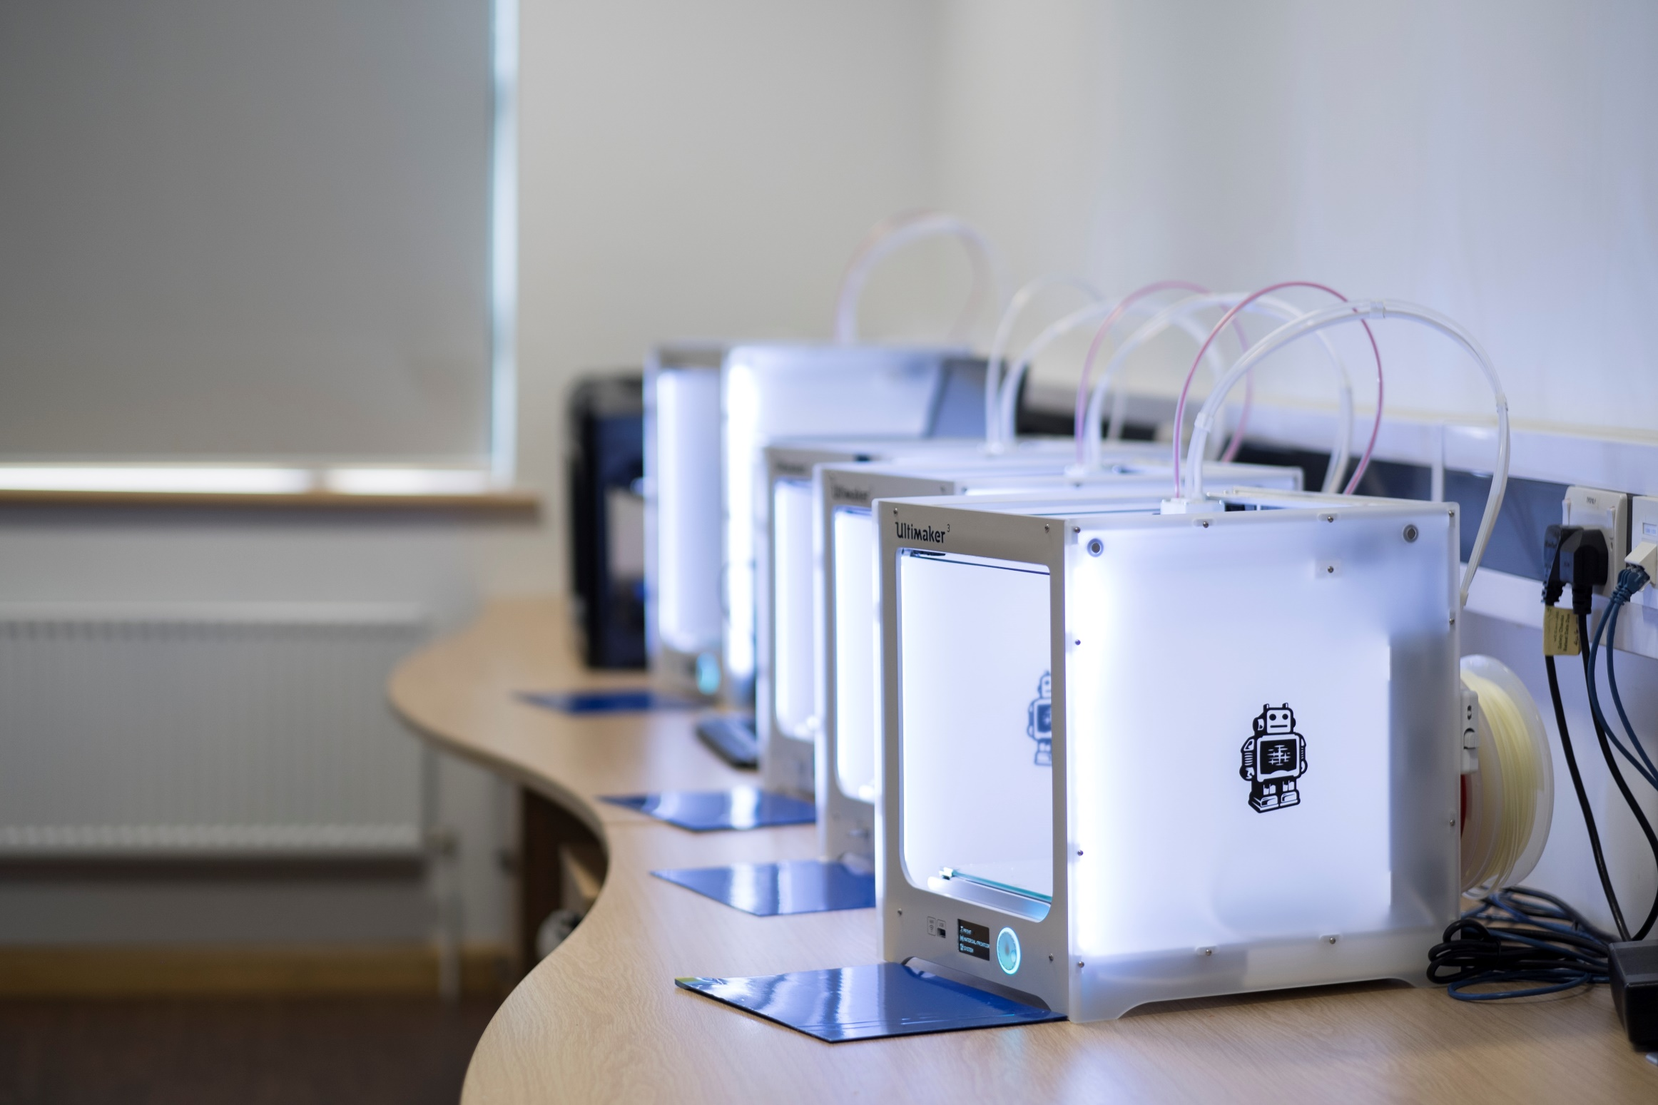

Slide 14
Through a variety of mechanisms and partnerships, the centre offers access to markets, finance, technology and skills
Notes:
The how, the ‘story’

Slide 15
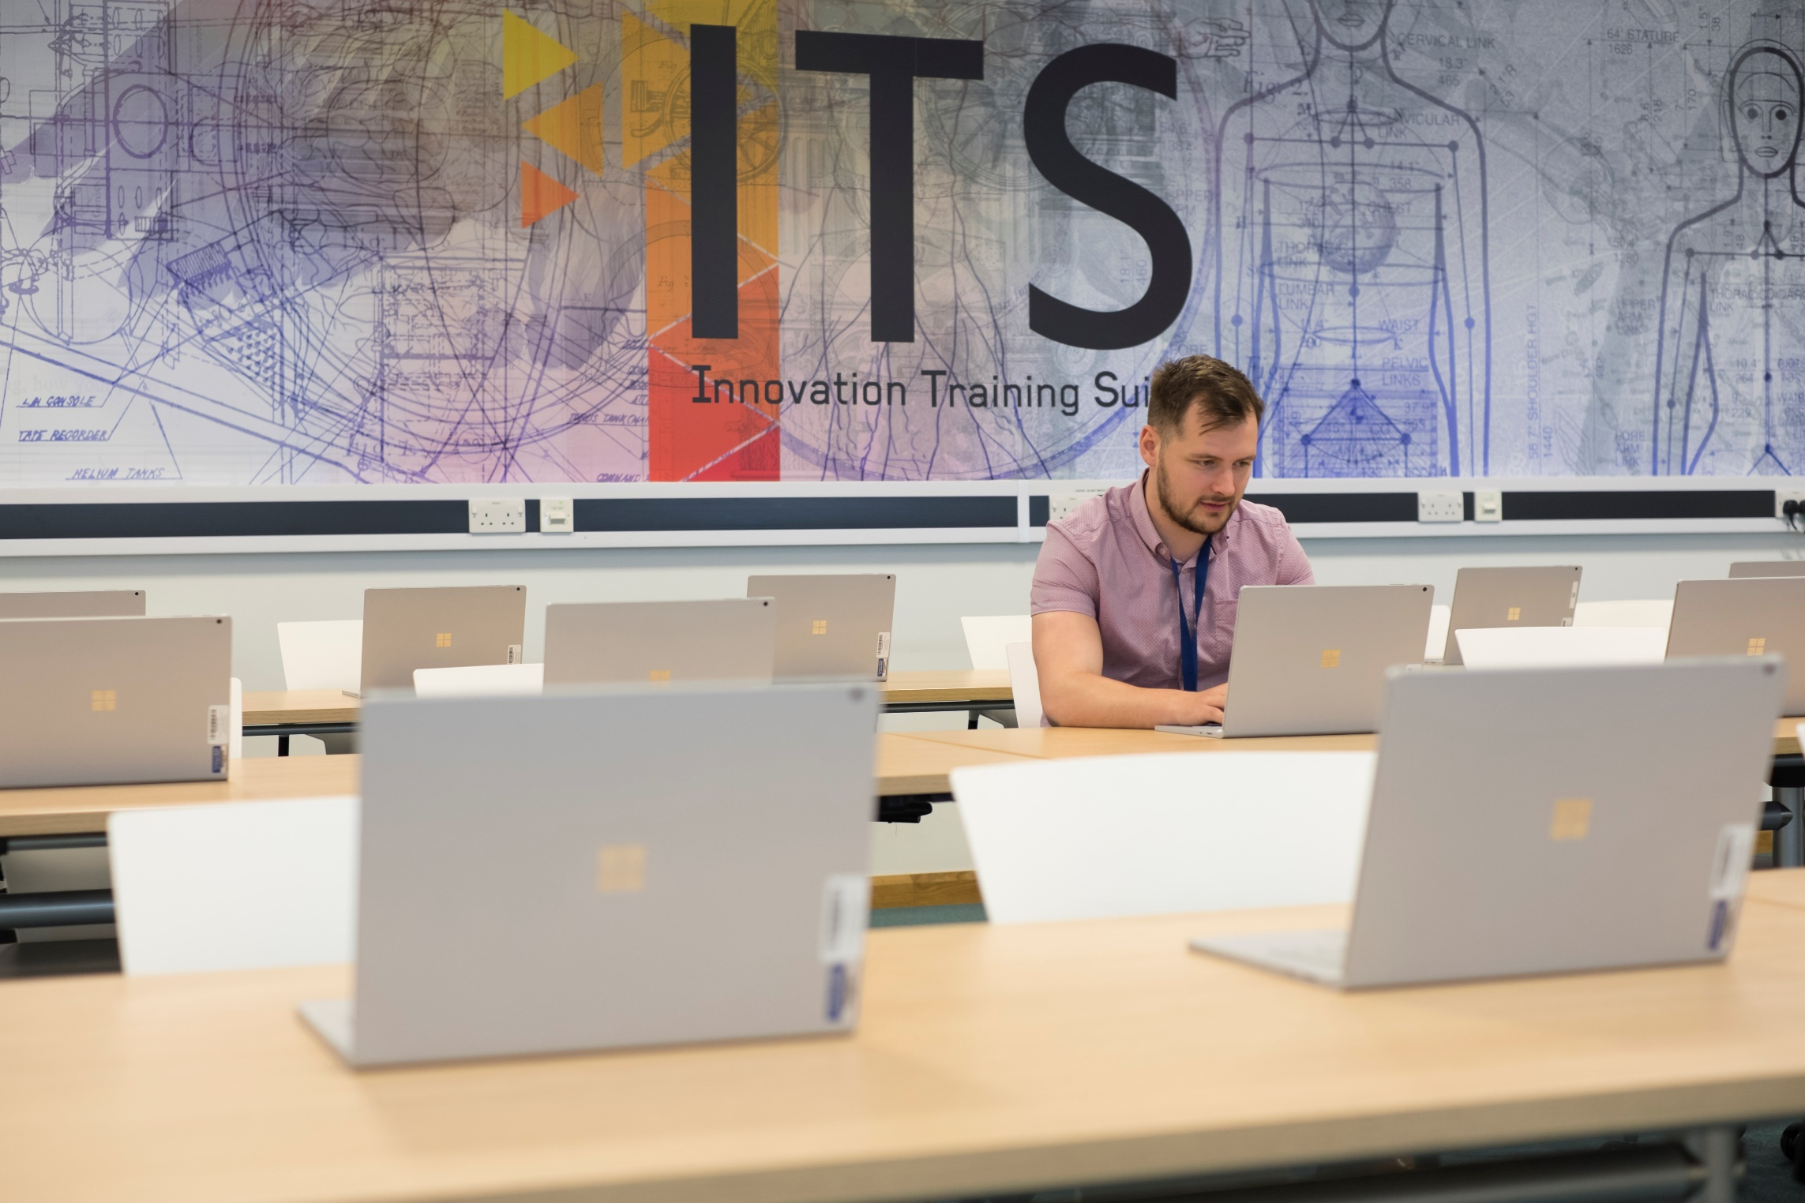

Slide 16
Currently working with approximately 350 companies in the Leeds City Region.
A focus on SMEs and open innovation.
Supporting SME growth by giving access to equipment they wouldn’t normally be able to learn about or invest in.
Notes:
The outcomes and impact on businesses in the Leeds City Region, with a particular focus on skills

Slide 17
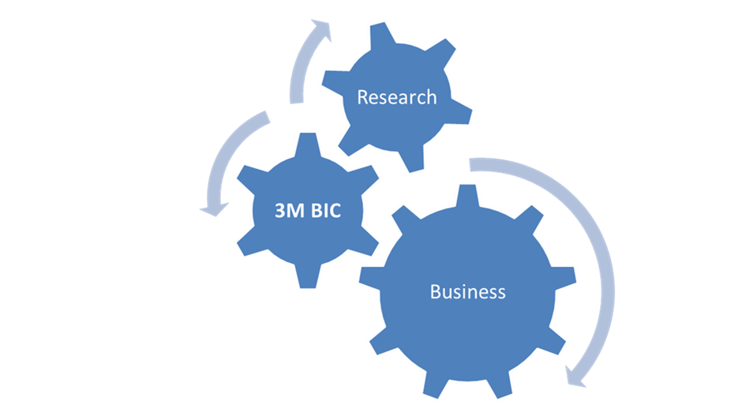

Slide 18


Slide 19

SOCIAL MOBILTY
COLLABORATION
Notes:
This project follows the elements of success, Social Mobility and Collaboration

Slide 20
To provide additional value to employers
Increase the impact of training delivered by the college, for both the business and the individual
Notes:
The goals and what the project set out to achieve

Slide 21
The college develops learning packages, which are supported with legacy programmes
Programmes have been designed to be interactive and require real-world interaction between participants
Notes:
The how, the ‘story’

Slide 22
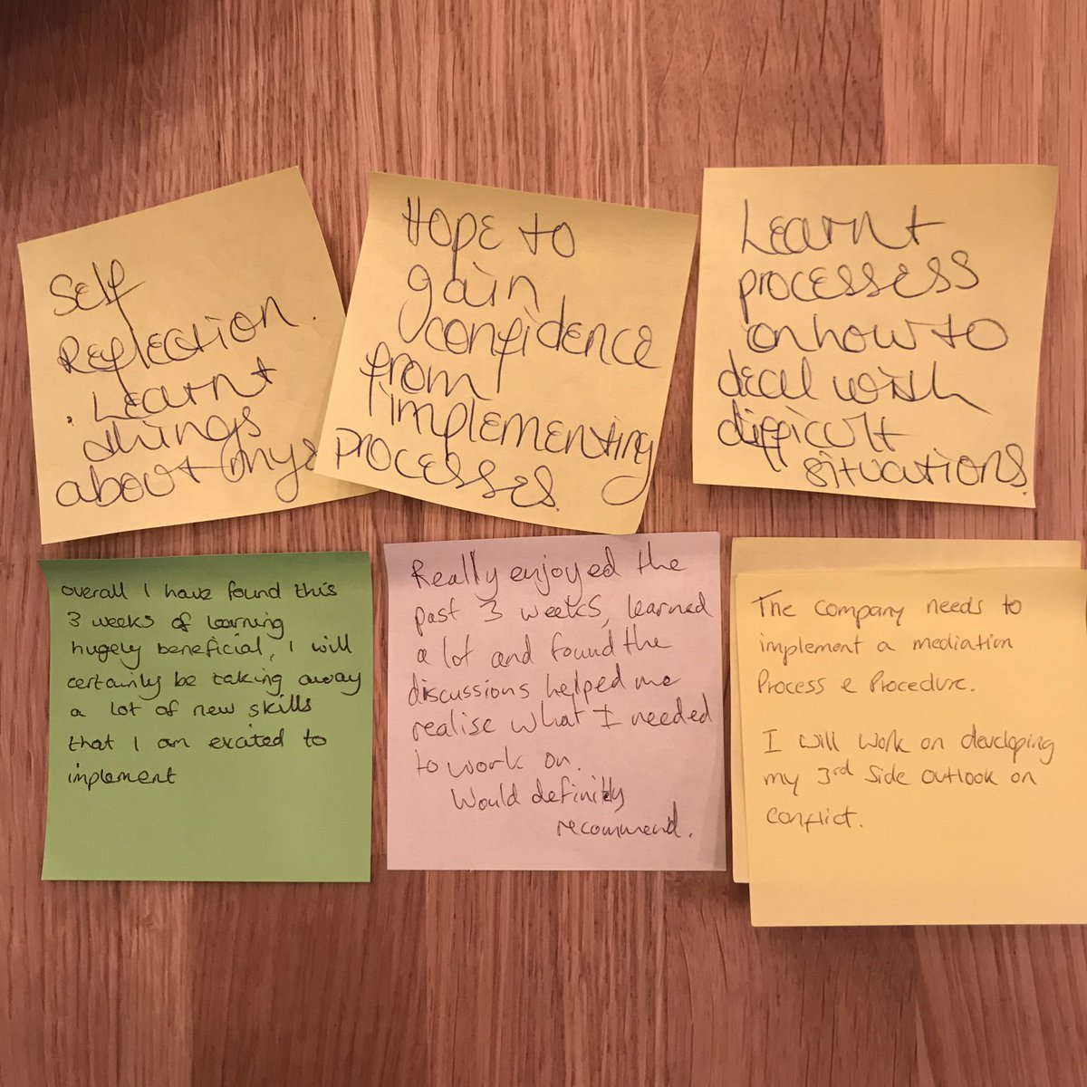
Notes:
The outcomes and impact on businesses in the Leeds City Region, with a particular focus on skills

Slide 23
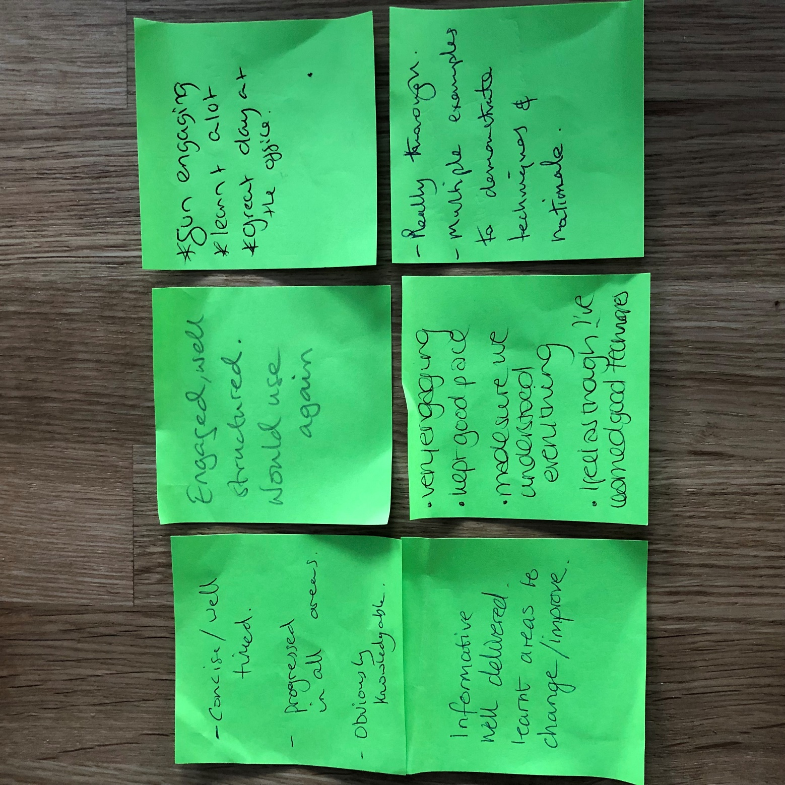

Slide 24


Slide 25
COLLABORATION
Notes:
This project follows the element of success, Collaboration

Slide 26
Increase employer understanding of their role in apprenticeship standards
To design and maintain programmes that provide outstanding learning experiences
Notes:
The goals and what the project set out to achieve

Slide 27
Apprenticeship
Learner
Practitioner
Employer

Slide 28
Employer engagement team CPD session
Action learning
Collaboration with other projects
Notes:
The how, the ‘story’

Slide 29
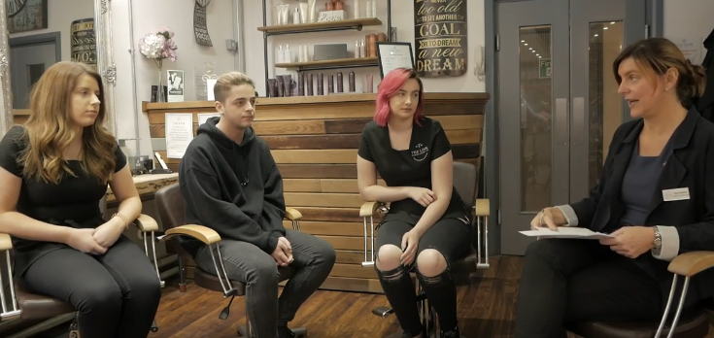

Slide 30
Improved communication with learner and employers
88% employers identified that they were clear as to the requirements of the programme and that they felt they could now plan training which would be beneficial to the learners
Notes:
The outcomes and impact on businesses in the Leeds City Region

Slide 31


Slide 32
SOCIAL MOBILTY
COLLABORATION
Notes:
This project follows the element of success, Collaboration

Slide 33

Valmet
Acorn Mobility Services
J. Stell & Sons
Linear Composites
Cirteq
Univer
Teconnex
Five Landis
Rymer Engineering
Metal Box
Bradford Armature Winding Co
Thistle Rose Holdings
SFS Group Fastening Technology
Principle Healthcare
Byworth Boilers
Drammock International
Racks Industries
Produmax
Airedale Springs
Marlin Windows
Sharp Cutters
Tarmac
Yorkshire Precision Engineering
Multiflight

Slide 34
Ageing workforce
Flexibility
Skills gaps
Local needs
Responsive
Notes:
The goals and what the project set out to achieve

Slide 35
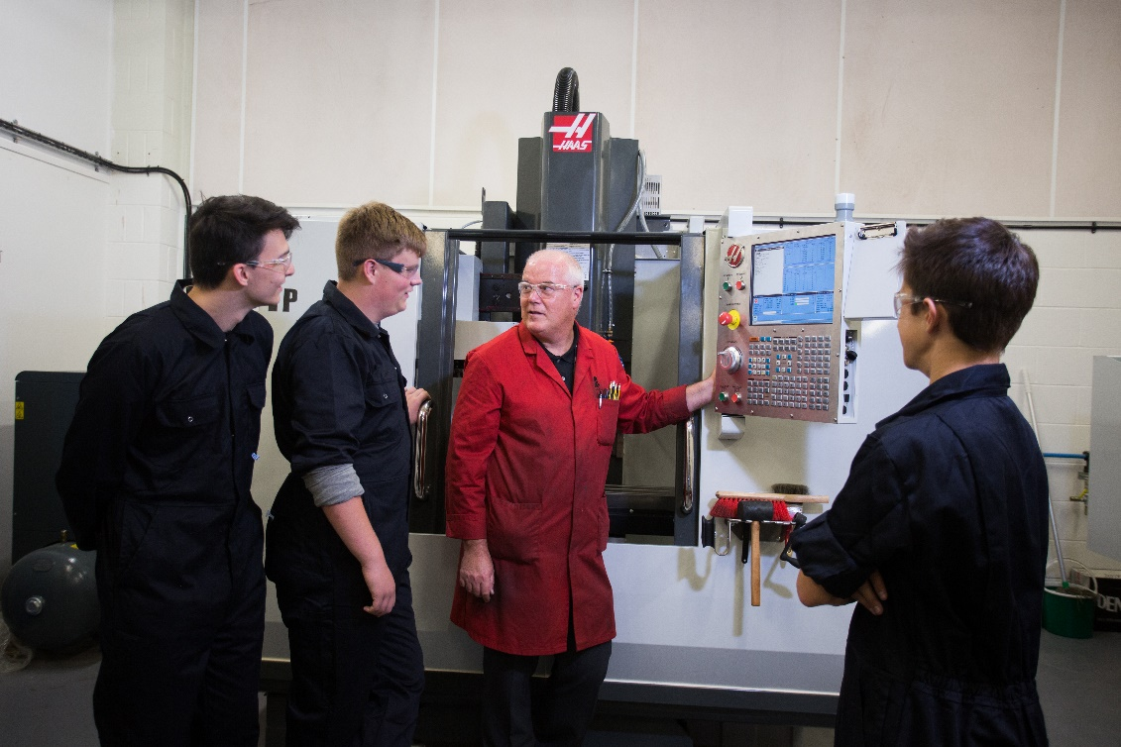
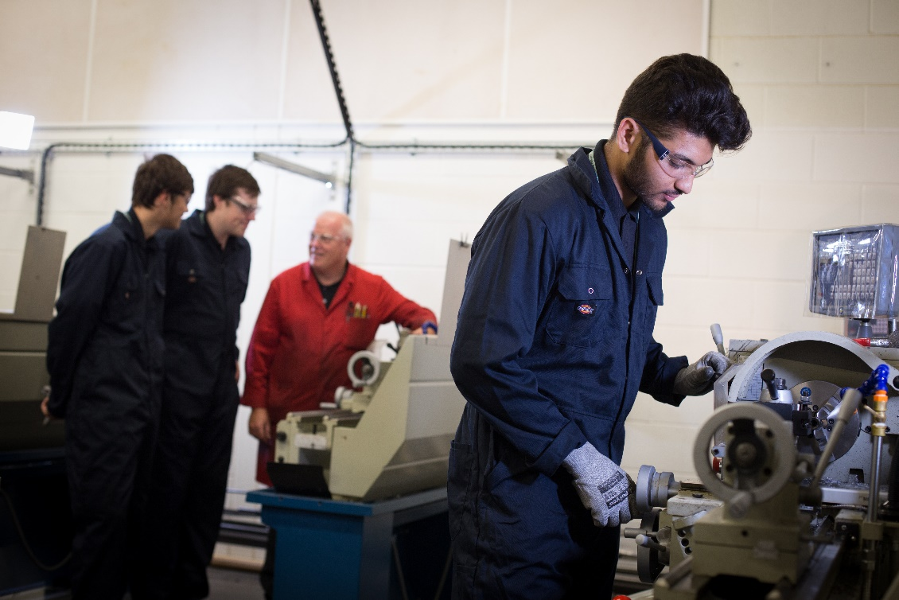
Notes:
The how, the ‘story’

Slide 36
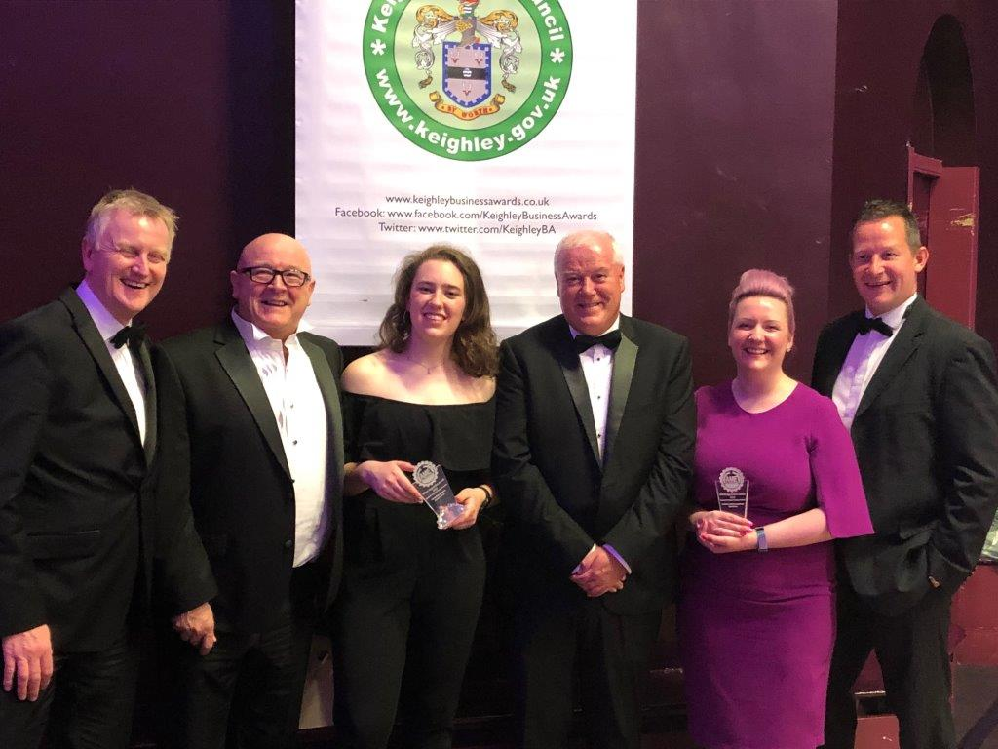
Keighley & District Business Awards 2019
Milner Awards
Notes:
The outcomes and impact on businesses in the Leeds City Region

Slide 37
Leeds City Region
Skills Network
SHOWCASE

Slide 38
Kevin Green, keynote speaker
Chief Executive and founder of What’s Next Consultancy

Slide 40
Skills - formula for success
Kevin Green Founder & CEO
5th July 2019

Slide 41

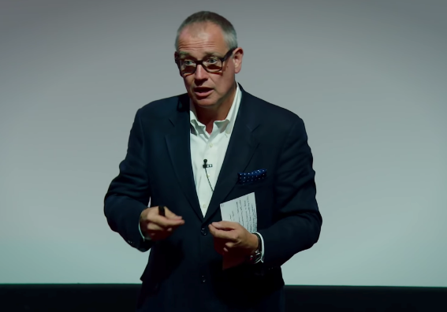
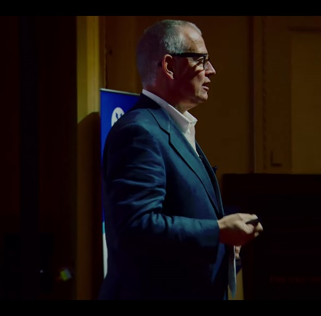
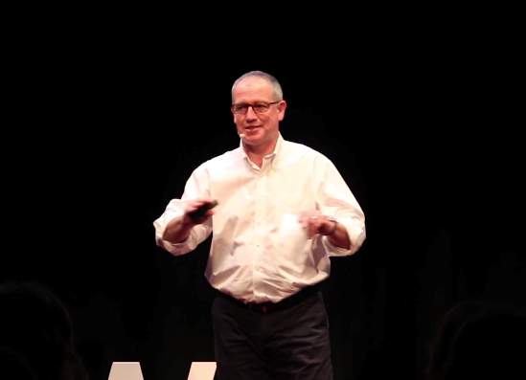
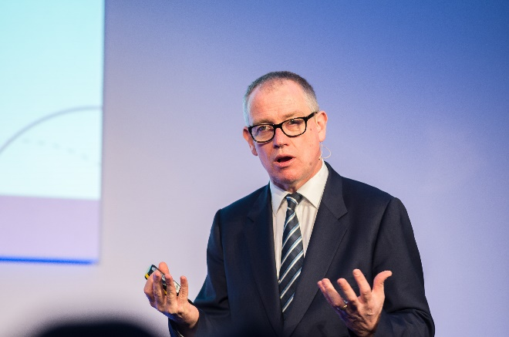
Who is Kevin Green?
CEO for REC for 10 years
HRD for Royal Mail
Tedx presenter
Client portfolio of human capital businesses
Author of Competitive People Strategy
Kevin Green
@kevingreenwnc
kevin@whatsnextconsultancy.uk.com

Slide 42
In the next 30 mins…..
Jobs Market
The future of work 4 macro trends
Why skills are becoming more important
AED = P formula for success
Leadership

Slide 43

The Perfect Storm

Slide 44

Labour, Skill and Talent Shortages

Slide 45




Full blown Talent Crisis
Millennials
at work
Flexibility
Ageing
Immigration

Slide 46
4 Macro employment trends

Slide 47
85
%
Of business’ value is derived from intangibles = people

Slide 48


Return on Human Capital
Number of employees 118k
Market cap per employee $298k
Number of employees 25k
Market cap per employee $21m

Slide 49
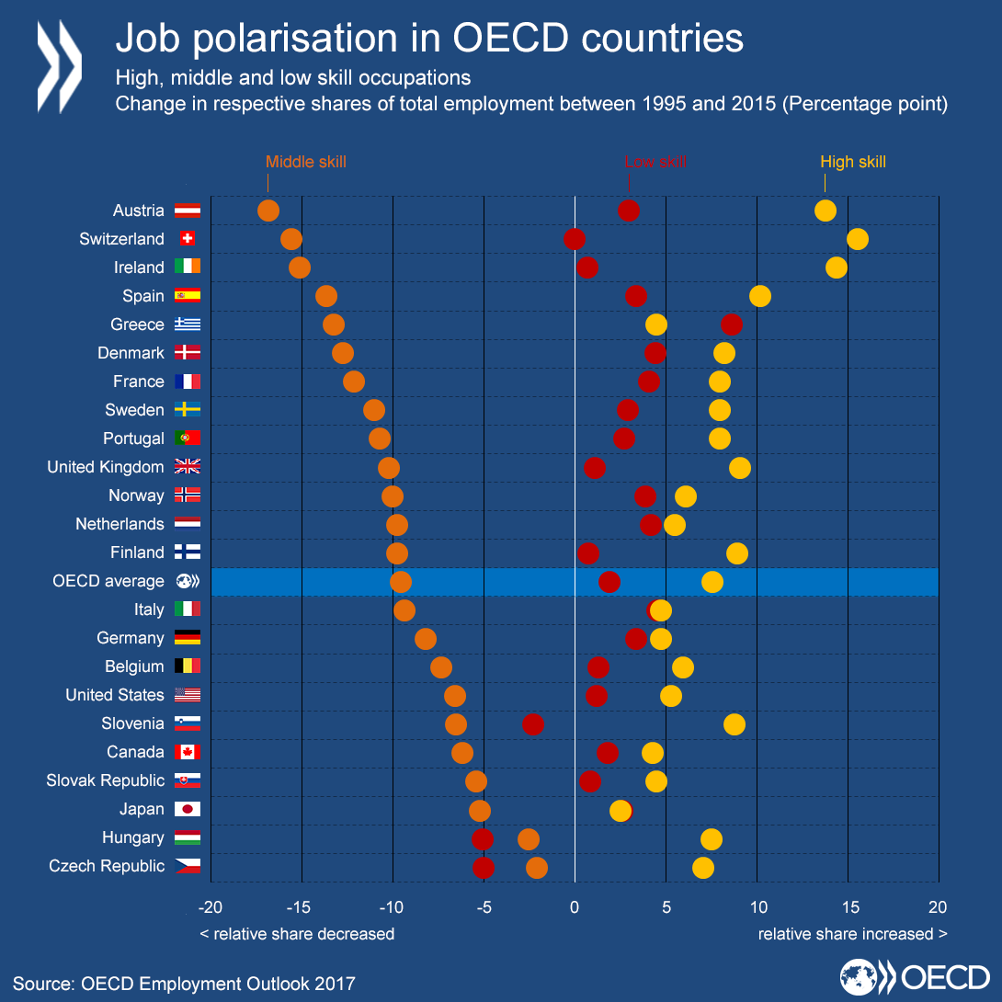
Job
Polarisation

Slide 50

AI &
Machine learning

Slide 51
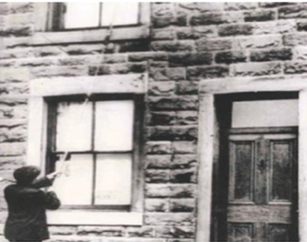
Tech always destroys jobs

Slide 52

Education has to change
Exam factories to life-long learning

Slide 53
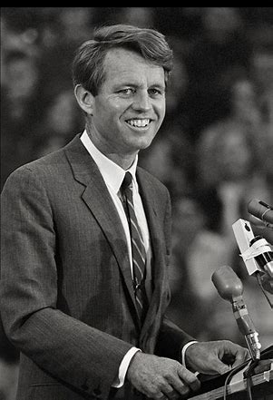
There is an old Chinese curse that says…
“May he live in interesting times”
Like it or not, we live in interesting times.
They are times of danger and uncertainty;
but they are also the most creative of any
time in the history of mankind.

Slide 54
The Formula For Success
AED=P

Slide 55
A =
Attraction

Slide 56

Employer Branding

Slide 57
80
Candidate experience
%

Slide 58

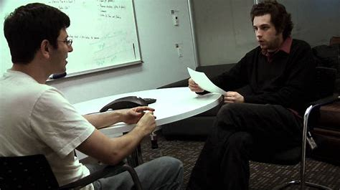

Interviews?

Slide 59
E =
Engagement

Slide 60

“
I've done my best to live the right way, I get up every morning and go to work each day, But your eyes go blind and your blood runs cold, Sometimes I feel so weak, I just want to explode.
Through the mansions of fear, through the mansions of pain, I see my daddy walking through them factory gates in the rain,Factory takes his hearing, factory gives him life, The working, the working, just the working life.
”

Slide 61
What motivates and engages people at work?
Purpose
Autonomy
Mastery

Slide 62
D =
Development

Slide 63

Refreshing Skills
Art & craft
Play
Robot teachers
We are all going to die
“Every child is an artist, the problem is how to remain one as we age”

Slide 64
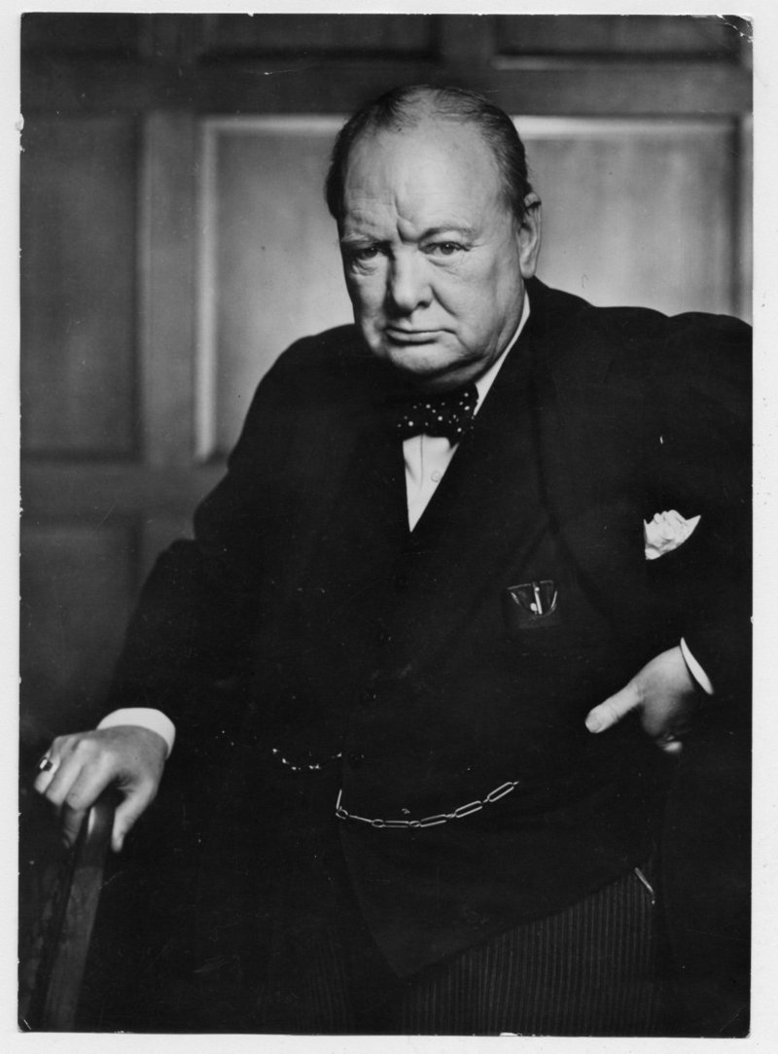



Slide 65
Providers of Development
‘The world belongs to you if’
More personalised or customised
Blended learning – app based
B to B to E
More personal development aligned to knowledge
Creativity and soft skills
Co-create with employers and learners

Slide 66
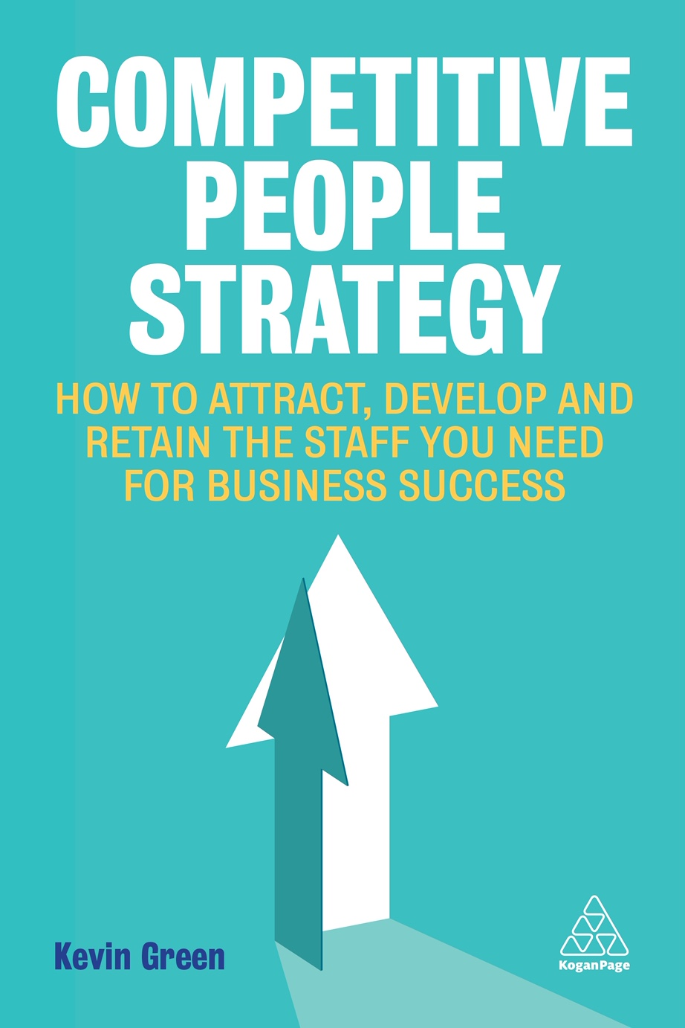
Competitive people strategy

Slide 67
Questions ?

Slide 69


Formula for Success
WYCC skills offer

Slide 70
Joanne Patrickson
WYCC Project Director

Slide 71
Long history of collaboration
Linking employers, industry bodies and training providers to deliver workforce skills
Responding to the region’s skills priorities using ESIF
Connecting intelligence and demand with opportunity

Slide 72
Sharlotte Wood
WYCC Skills Advisor

Slide 73


Case study:

Slide 74
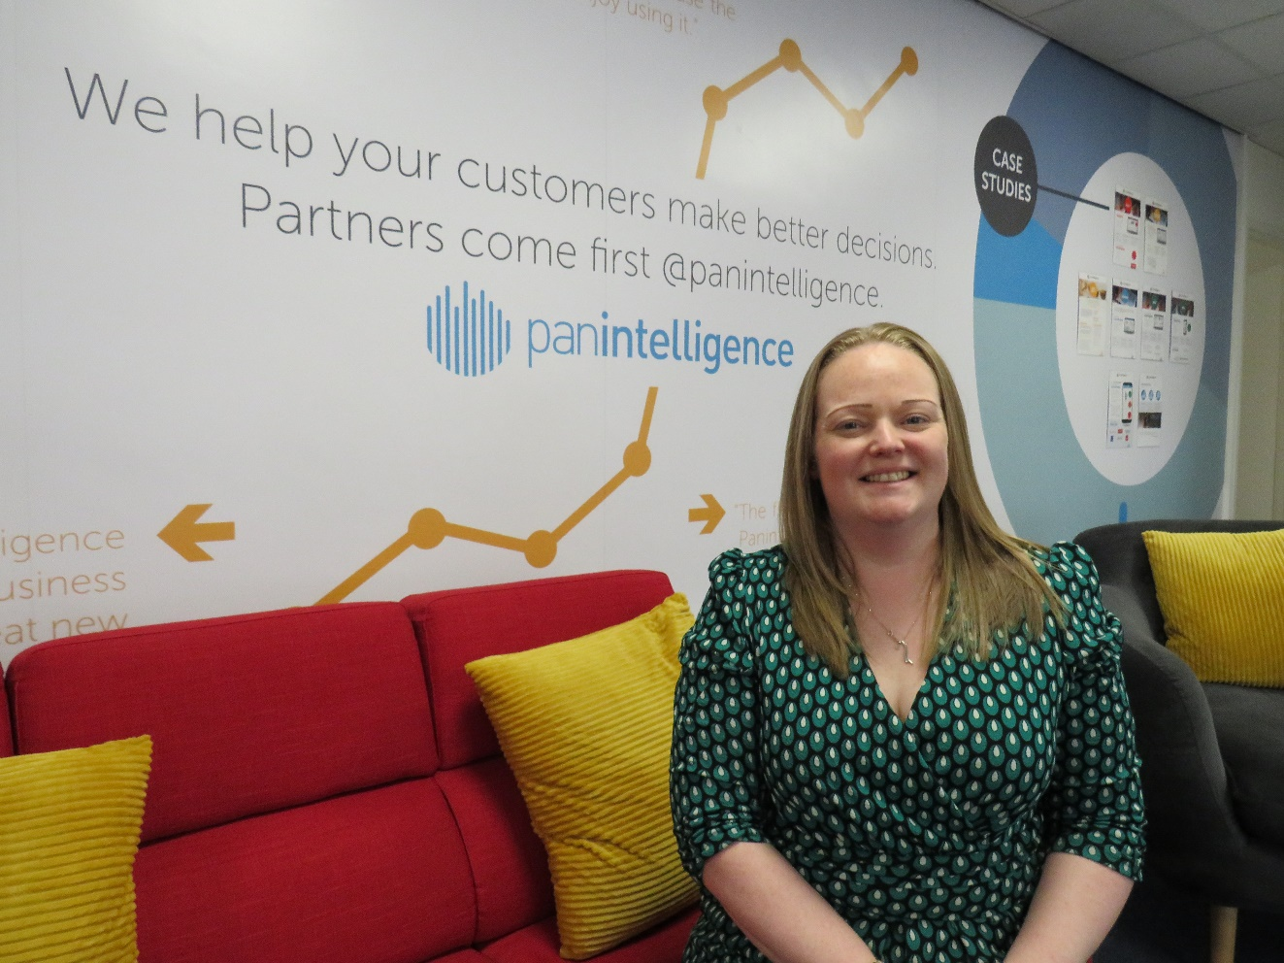
“The reality was when I searched The Skills Service online, you were easy to find. I found the consortium, made a phone call, got through to Sharlotte, she came on site within a week and within 10 days the training was booked!”
“The ESF application process was really easy, Sharlotte was extremely informative particularly because it wasn’t like I was choosing something out of a brochure. Sharlotte kept everything up-to-date, we had good engagement with QA whose trainer was extremely insightful and supportive.”
Charlotte Bailey, Operations Director - Panintelligence

Slide 75
“The ESF funding has been reinvested back into the company. Training is important for our staff happiness and wellbeing, staff feel like they’ve been invested in as well and that’s really important for Panintelligence. Our values are Supportive, Open, and Innovative and part of that comes from investing in staff as individuals so that they can be those things.”
“I would wholeheartedly recommend The Skills Service, in fact, I already have to other Leeds City Region businesses! It’s been a good experience, something I wish we’d capitalised on sooner.”
Charlotte Bailey, Operations Director - Panintelligence

Slide 76
Dr Joanne Harvatt
WYCC Sector Engagement Specialist

Slide 77

Case study:
Reach Higher in Construction

Slide 78







“We need training to support individuals wanting to progress, those who act as a go between the site and the office, and people moving into a more client-facing role” (Gary Morgan)
“Training that reduces work stress for employees and sustains and safeguards the industry for the future” (Beverley Pearce, HB Projects)

Slide 79
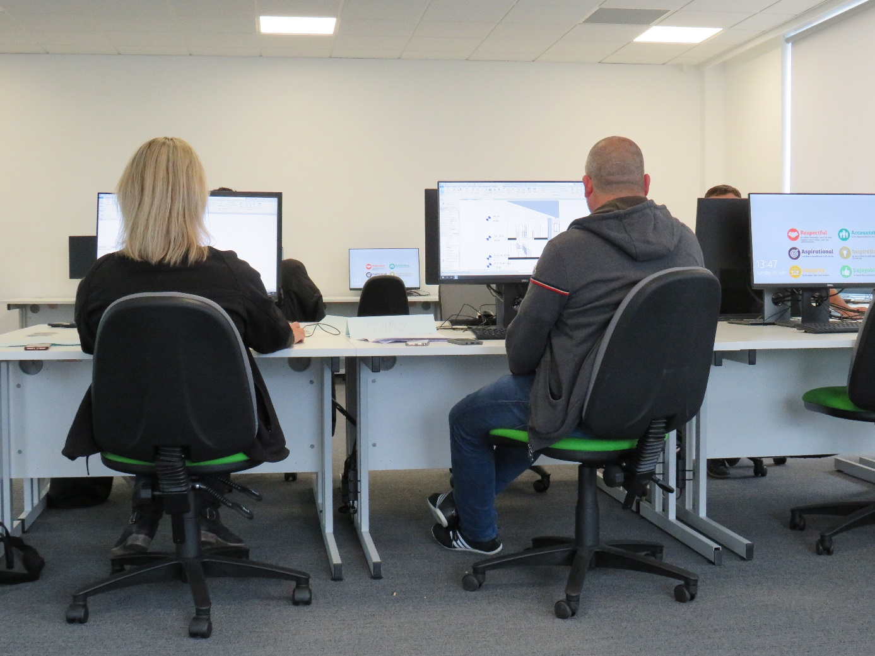
“I worked closely with the West Yorkshire Consortium of Colleges to help develop the learning that Leeds College of Building is offering through the Reach Higher project. I was a site manager for 15 years and I’ve been a construction manager for four years.
When I first moved into an office environment, I felt out of my depth as it’s so different to working on site. My experience of learning what it’s like to move from site to office has fed into what this Reach Higher course should be, the course is a stepping stone to bring knowledge from on site into office.
The experience and the talent is there and waiting on site, it’s great to see a process to help with learning to bring people in office. For me personally, going into the office environment was fantastic for my home life and work like balance.“
Gary Morgan – Delegate - Sigma

Slide 80
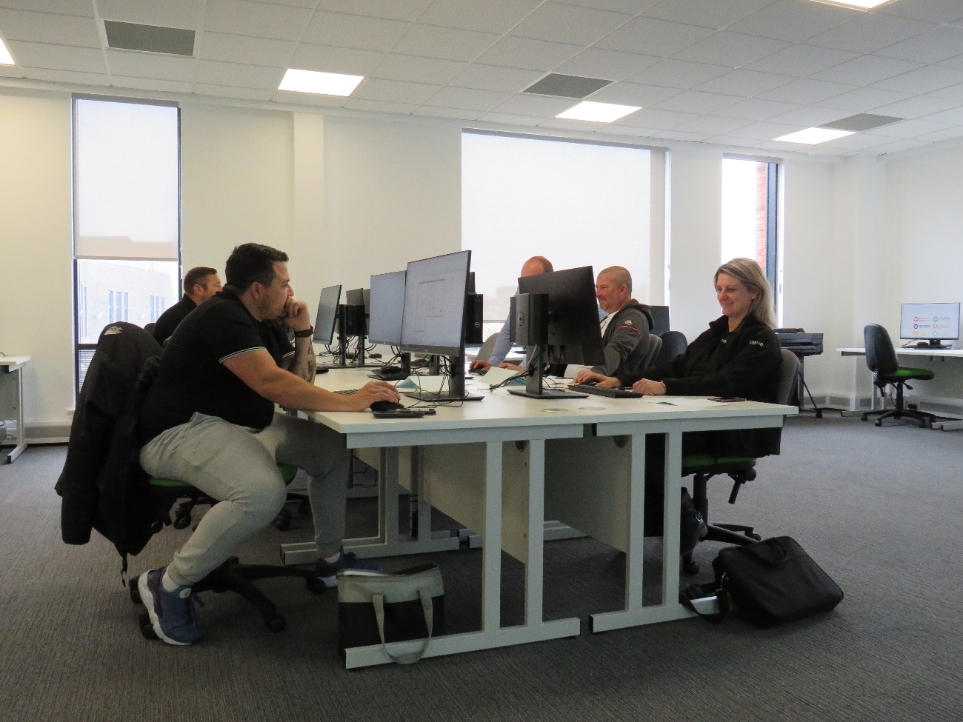
“I recently moved to management from tools, it’s been a massive change and I feel like I’m starting from scratch. Luckily my team at Colas are really supportive, particularly when it comes to getting the right skills to do my job well, which is where this learning comes in. I’ve been at Colas for 10 years, so moving to management and taking part in these courses will have a big impact on my career.”
Shane Parnham – Delegate - Colas

Slide 81
Councillor Susan Hinchcliffe
Chair of the West Yorkshire Combined Authority

Slide 82


FUTURE-READY SKILLS SYSTEM IN A DEVOLVED UK

Slide 83
Notes:
The aim of the commission is to develop a blueprint for an education and skills system to deliver the outcomes needed at local level
Why is the commission needed?
Local areas lag on skills for economic growth
Shortages of skilled people that employers need
Under-utilisation of qualified people
Job-related training in decline
Lack of inclusion and social mobility
Low-skilled not receiving training
Low participation in lifelong learning
What is different about this commission:
Recommendations that have national significance using LCR as the case study
Profile and expertise of the Commissioners; including nation representatives from think tanks, employers (Beer Hawk, IBM, Sky, BBC, Produmax, Bupa, Keepmoat and PWC as well as CBI)
Opportunities and planning for devolution and Brexit.
What are we aiming for:
Substantial influence on national policy thinking
A practical blue-print for skills that gives local areas strategic influence but supports national coherence
A more effective system that delivers against the outcomes that really matter

Slide 84
Notes:
Three themes to provide focus / structure to the work of the Commission, whilst considering the local dimension:
Technical education and training 2. Careers information and inspiration 3. Workforce skills
What have we learnt so far?
The call for evidence has highlighted that there are some areas where there are a majority consensus e.g. careers information and inspiration where the landscape is overcrowded, lacks clear governance and better value for money could be achieved by commissioning regional programmes for people both in work and in education and work of all ages – linked to the local labour market.
Apprenticeships are generally seen a s positive reform
There is a great concern about the sharp decline in adult learning and more needs to be done to address this
Both the FRSC call for evidence responses (skills commission) and Augar review highlight some of the inequalities in funding, particularly further education, although the Augar review doesn’t go as far as considering the local dimension which is something the FRSC will be looking at

Slide 85


Delivery Agreements
www.the-lep.com/media/2350/delivery-agreements-2019.pdf
Notes:
Developed following the Area Reviews in partnership with the seven institutions and the local authority representatives
To build on the relationships developed during the Area Review process, to give focus to and influence future curriculum development inline with Employment and Skills Plan 2016 – 2020/LMI evidence
Anticipation of devolution of Adult Education Budget
Seven Delivery Agreement documents published July 2017
Informal reviews held autumn 2017 and summer 2018
First formal review winter 2018/19
First formal report published 6 June 2019

Slide 86
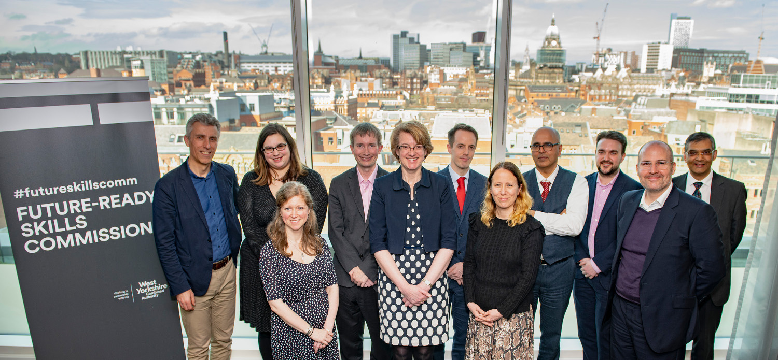
Keep in touch
Email: skillscommission@westyorks-ca.gov.uk
www.futurereadyskillscommission.com
Twitter: @westyorkshireCA #futureskillscomm
Notes:
For more information about the Commission and its Commissioners, please visit our website or follow us on twitter – details are on the screen.

Slide 87

Thank you

Slide 88
Q&A PANEL
Slido.com - #FormulaForSuccess

Slide 89
Thank you
Nav Chohan
Chair of the Leeds City Region Skills Network

Slide 90
Content available to download from Slido
Slido.com - #FormulaForSuccess

Slide 91
www.leedscityregionskillsnetwork.co.uk
www.westyorkshirecolleges.co.uk

